Slide 1
Lab 1: Conceptual Design
Member team : REDA Lakhlouf

Slide 2
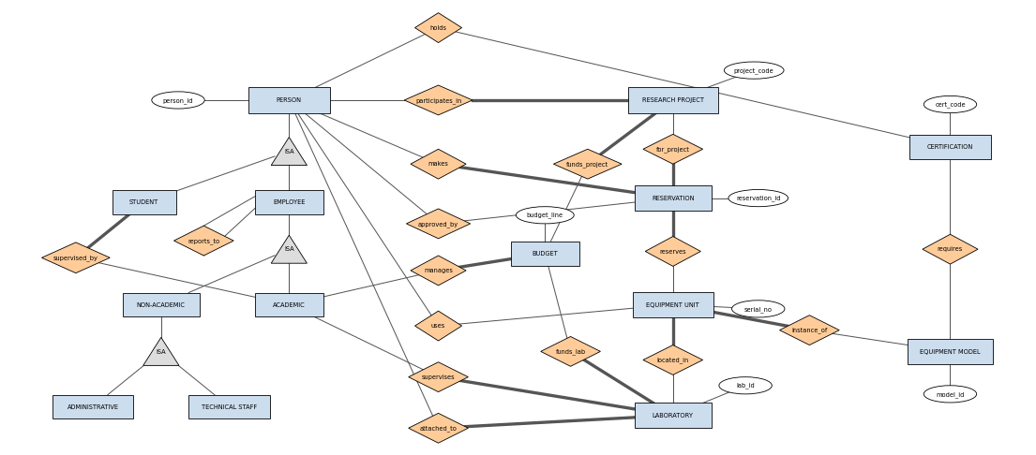

Slide 3
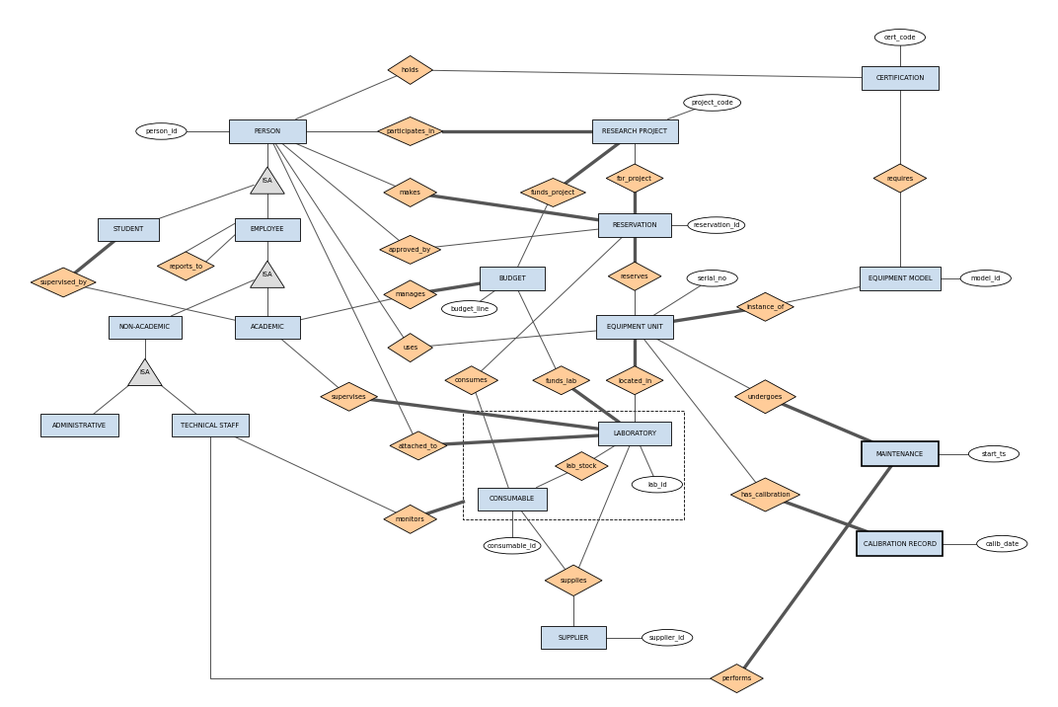

Slide 4
Attributes and relations Inforamtions
Relation | Entités Liées | Type | Attributs
supervised | Student, Academic | Many-to-many | Aucun
reports_to | Employee, Employee | One-to-many | Aucun
attached_to | Person, Laboratory | Many-to-many | Aucun
supervises | Faculty, Laboratory | One-to-many | Aucun
participates_in | Person, Research Project | Many-to-many | role
makes | Person, Reservation | One-to-many | Aucun
manages | Academic, Budget | One-to-many | Aucun

Slide 5
Attributes and relations Inforamtions
Relation | Entités Liées | Type | Attributs
approved_by | Reservation, Research Project | One-to-many | Aucun
funds_project | Budget, Research Project | Many-to-many | Aucun
funds_lab | Budget, Laboratory | Many-to-many | Aucun
instance_of | Equipment Unit, Model | Many-to-one | Aucun
located_in | Equipment Unit, Laboratory | Many-to-one | Aucun
uses | Person, Equipment Unit | Many-to-many | Aucun
consumes | Reservation, Consumable | Many-to-many | quantity
reserves | Reservation, Equipment Unit | Many-to-many | Aucun

Slide 6
Attributes and relations Inforamtions
Relation | Entités Liées | Type | Attributs
undergoes_maint | Equipment Unit, Maintenance | One-to-many | Aucun
requires | Equipment Model, Certification | Many-to-many | Aucun
holds | Person, Certification | Many-to-many | date, exp, result
performs | Technical Staff, Maintenance | One-to-many | Aucun
has_calibration | Equipment Unit, Calibration | One-to-many | Aucun
lab_stock (Agr.) | Laboratory, Consumable | Many-to-many | qty, date, storage
monitors | Technical Staff, lab_stock | One-to-many | start_date
supplies | Supplier, lab_stock | Many-to-many | unit_price

Slide 7
Attributes Inforamtions
Entity | Type | Key Attribute(s) | All Other Attributes
PERSON | Superclass | person_id | first_name, last_name, email, affiliation, start_date, end_date (opt.)
STUDENT | ISA Person | person_id (inherited) | program (BSc/BEng/MSc/PhD)
EMPLOYEE | ISA Person | person_id (inherited) | phone, office_space, position
LABORATORY | Entity | lab_id | name, building, room_number, discipline/research_area
RESEARCH_PROJECT | Entity | project_code | title, start_date, end_date, status (Proposed/Active/Suspended/Completed/Cancelled)
BUDGET | Entity | budget_line | amount_granted, amount_disbursed, start_date, end_date
CERTIFICATION | Entity | cert_code | title, issuing_authority, validity_period, safety_level

Slide 8
Attribute Information
Entity | Type | Key Attribute | All Other Attributes
EQUIP_MODEL | Entity | model_id | commercial_name, manufacturer, category, req_environment, special_training (bool)
EQUIP_UNIT | Weak Entity | serial_no (partial) | acquisition_date, purchase_cost, op_status (InService/UnderMaint/OutOfService/Retired), portable/fixed
MAINTENANCE | Weak Entity | start_ts (partial) | end_ts, type (Preventive/Corrective), description, cost, outcome (Resolved/FollowUpRequired)
CALIBRATION_RECORD | Weak Entity | calib_date (partial) | calib_type, result (Pass/Fail/Adjusted), next_due_date, remarks
RESERVATION | Entity | reservation_id | submission_ts, planned_start, planned_end, purpose, status (Pending/Approved/Rejected/Cancelled/Completed)
CONSUMABLE | Entity | consumable_id | name, unit_of_measure, hazard_level, reorder_threshold
SUPPLIER | Entity | supplier_id | name, contact_email, phone_number

